Slide 1
Program/Policy Evaluation and Assessment Concepts and Issues in Economic Evaluation
Nhial T. Tutlam, PhD, MPH
November 29, 2018

Slide 2
Introduction
How does economic evaluation differ from typical program evaluation?
Program evaluation: focuses on how well the actual results/outcomes of a program compare with intended outcomes and whether those outcomes can be attributed to the program
Economic evaluation: explicitly compares costs and benefits, using economic efficiency criterion
Economic Efficiency: the net social value of a project or program, estimated by subtracting the discounted social cost from the discounted social benefit

Slide 3
Introduction
Economic evaluation has rich history grounded in both economic theory and public sector decision making
Over the past few decades demand for economic evaluation has increased
Increase efficiency in use of public resources – heath care
In this chapter we will discuss three principal forms of economic evaluation
We will particularly focus on the Cost-Benefit Analysis (CBA) form of economic evaluation

Slide 4
Why an Evaluator Needs to Know About Economic Evaluation
Due to fiscal constraints economic evaluation will have a huge role in program evaluation
Example: Importance of containing cost and assessing relative efficiency and effectiveness of interventions in healthcare field is growing
It is important to know how economic evaluation intersects with program evaluation
Have basic knowledge and be critical reader of economic evaluation
Critically assess economic evaluation that may be used to justify program or policy decisions
Reviews have found serious methodological flaws in significant number of economic evaluations (Jefferson et al. 2002)

Slide 5
Why an Evaluator Needs to Know About Economic Evaluation
Some times, economic evaluations can be done in a way that facilitate economic evaluation of the outcomes of an intervention or program
Alternatively, prior to program implementation, a program evaluator may review economic analysis to identify variables/data that would be needed to conduct further evaluation

Slide 6
Connecting Economic Evaluation with Program Evaluation: Program Complexity and Outcome Attribution
Program Complexity and Determining Cost-Effectiveness of Program Success
The more complicated/complex a program is, the more challenging it is to coordinate and implement multiple factors to achieve program success
Examples of simple programs: Road maintenance project
Construct a ratio of cost per lane-mile maintained
Measure of cost-effectiveness compared overtime
Can easily track and be sure that the costs (program inputs) are responsible for observed outcomes

Slide 7
Connecting Economic Evaluation with Program Evaluation: Program Complexity and Outcome Attribution
Program Complexity and Determining Cost-Effectiveness of Program Success
Measure of cost-effectiveness is a valid measure of program accomplishments
Measuring performance roughly equivalent to evaluating the effectiveness of the program
Even in simple programs, it can be difficult to determine precise cost-effectiveness
Weather changes affecting highway maintenance can be confounders

Slide 8
Connecting Economic Evaluation with Program Evaluation: Program Complexity and Outcome Attribution
Program Complexity and Determining Cost-Effectiveness of Program Success
Example of Complex Program: Modification of Parenting Behavior
Programs designed to change knowledge, attitudes, beliefs, and behaviors are challenging to design and implement
Evaluation results of the “Troubled Families Program” in Britain yielded contradictory results:
Quantitative evaluation -> no overall effectiveness
Qualitative evaluation -> positive change in the families

Slide 9
Connecting Economic Evaluation with Program Evaluation: Program Complexity and Outcome Attribution
Program Complexity and Determining Cost-Effectiveness of Program Success
How to address assessment of complex programs
Nested logic models can be useful for capturing complexity
Anderson and colleagues (2011) proposed strategies for using logic models for systematic reviews of complex health programs
Lewis and colleagues (2017) proposed a framework tool for assessing and comparing complexity of interventions:
“Intervention Complexity Assessment Tool for Systematic Reviews” (iCAT-SR)

Slide 10
Connecting Economic Evaluation with Program Evaluation: Program Complexity and Outcome Attribution
The attribution Issue
Establishing causality is as relevant to economic evaluation as it is in regular program evaluation
Levin and McEwan (2001) emphasize importance of establishing causality before linking costs with observed outcomes
After resolving the attribution problem, then the ratio of the cost per program outcome would be a summary measure of the cost-effectiveness of that program

Slide 11
Connecting Economic Evaluation with Program Evaluation: Program Complexity and Outcome Attribution
The Attribution Issue
Example: The York Crime Prevention Program
Difficulties of developing a valid measure of the construct “burglaries committed”
Used “burglaries reported to the police”
Assessing cost-effectiveness: ratio of program cost per reduced burglaries (cost per burglary avoided)
Problem: assumes avoided burglaries only due to program efforts; economic improvements can confound this finding

Slide 12
Economic Evaluation in the Performance Management Cycle
Early in the cycle, economic evaluation can occur as programs are being proposed or designed
These are ex ante analysis
Occur as potential program or policy alternatives are being compared
Typically use existing theoretical models or experiences to predict future costs and benefits

Slide 13
Economic Evaluation in the Performance Management Cycle
Economic evaluation can also be conducted late in the cycle after the program has been implemented or after completion
These are ex post analysis
Conducted at the assessment and reporting phase
Based on actual costs and benefits accruing to a program
Depend, in part, on ability to assess the extent to which the policy or program caused observed outcomes

Slide 14
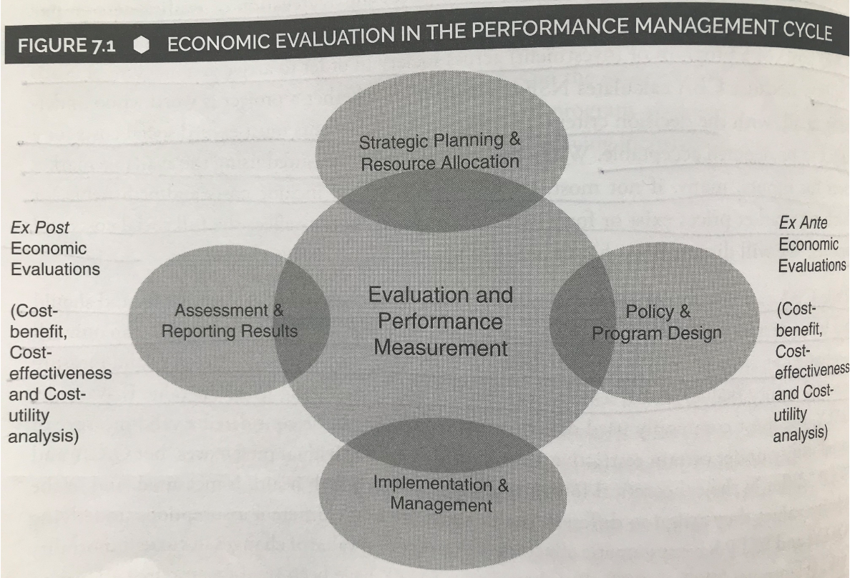

Slide 15
Types of Economic Evaluation
There are three main types of economic analysis:
Cost-benefit analysis (CBA)
Cost-effectiveness analysis (CEA)
Cost-utility analysis (CUA)
With all these types, the costs of the program are monetized, but for each the benefits are quantified differently
CBA: both cost and resulting benefits to society used to determine whether there is a Net Social Benefit (NSB)
CEA: cost per unit of a single non-monetized outcome calculated
CUA: cost per unit of a measure of multi-component utility are calculated

Slide 16
Cost-Benefit Analysis (CBA)
Conceptually most comprehensive and demanding to conduct
CBA can tell us whether the social benefits of an intervention exceed its social costs
The efficiency criterion aims to maximize social utility
Because it monetizes both the cost and benefits, can be used to choose between mutually exclusive alternatives, and to rank and prioritize projects

Slide 17
Cost-Benefit Analysis (CBA)
Usually conducted by economist or under the supervision of economist
Informed by review of the methodological literature and literature on comparable evaluation
Routinely used in environmental and infrastructure studies
A project or intervention is deemed acceptable if its social benefits exceed its social costs

Slide 18
Cost-Benefit Analysis (CBA)
CBA is conducted to estimate the value or relative value of an intervention to society
While one may be focused on government revenues and expenditures only, costs and benefits to all members of society are included
These include intangibles and externalities:
Intangibles: include loss of alternative uses such as loss of recreational opportunities for parks
Externalities: social value of (cost or benefit) a good or bad outcome that is a by-product of economic activity
Not reflected in market price
Affects parties other than those engaged in the activity

Slide 19
Cost-Benefit Analysis (CBA)
In economic evaluations taking on a social (jurisdictional) perspective, fees and charges for a program or intervention that are paid by residents to a government agency are not considered benefits
However, fees and charges collected from nonresidents are considered benefits
An economic evaluation that is fully grounded in welfare economics seeks to measure the aggregate social value of the costs and benefits of an intervention and not just to a particular government agency

Slide 20
Cost-Benefit Analysis (CBA)
There is widespread confusion between CBA and economic impact analysis (EIA)
While the objective of CBA is not to estimate the net social benefits (NSBs) of an investment, the objective of EIA is to estimate the impact of an investment on the gross domestic product (GDP) of an economy
NSB and GDP are not equivalent concepts
EIAs tends to overestimate benefits compared with CBAs, a reflection of the inadequacy of GDP as a measure of social welfare

Slide 21
Cost-Benefit Analysis (CBA)
Standing
In economic evaluation, the status determining whether the preferences of an individual or members of a group are included or excluded in estimates of social value
At the beginning of a CBA or other types of economic evaluation, the decision of who has standing has to be made
Agency bottom-line perspectives are sometimes used in CEAs, meaning the agency is the only “person” with standing in he analysis
Only appropriate if non-agency costs and benefits are very small
While the idea of including all residents of a jurisdiction or nation may seem simple conceptually, it can be confusing

Slide 22
Table 7.1 Selected Costs and Benefits of Transit Expansion Financed Through the Gasoline Tax
 | Transit Users | Private vehicle Users | Transit Authority | Society
Tax, fares, and service effects before change in behavior
Gasoline tax | No effect | Cost | Benefit | No effect
Fares | Cost | No effect | Benefit | No effect
Value (utility of increased service) | Benefit | No effect | No effect | Benefit
Opportunity cost of resources for expansion | No effect | No effect | Cost | Cost
Reduction in negative externalities as a result of switch from driving to train
Reduced Congestion | Benefit | Benefit | No effect | Benefit
Reduced pollution | Benefit | Benefit | No effect | Benefit
Reduced green house gas emissions | Benefit | Benefit | No effect | Benefit
Total | Benefit | TBD | No effect | TBD

Slide 23
Cost-Benefit Analysis (CBA)
Valuing Nonmarket Impacts
A project or intervention that reduces externalities tends to generate social benefits that cannot be valued using market prices
There have been methodological improvements in the valuation of nonmarket costs and benefits in the past three decades
In the absence of a market for goods, WTP and WTA are estimated using a variety of methods
Willingness-to-pay (WTP) for benefits
Willingness-to-accept (WTA)
These methods are classified as revealed preferences and stated preferences methods

Slide 24
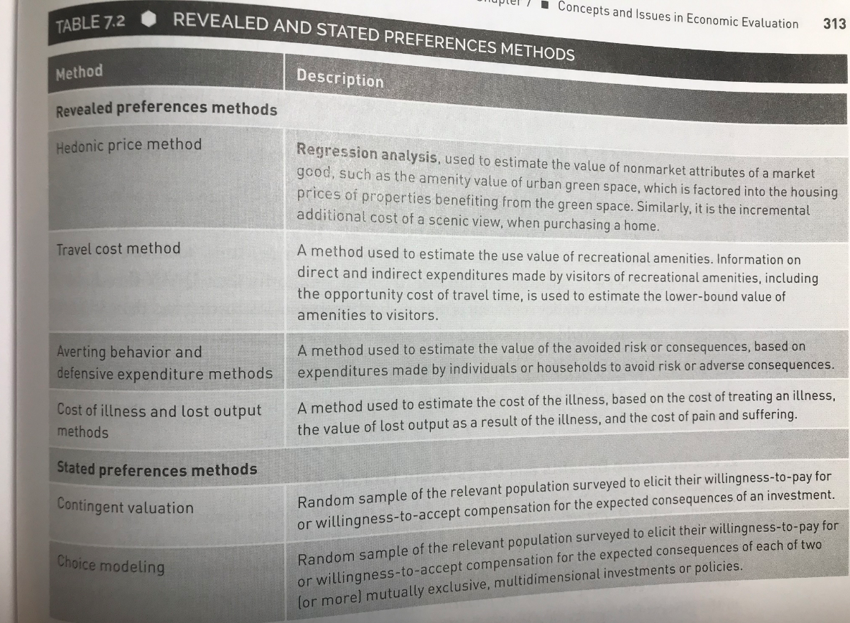

Slide 25
Cost-Benefit Analysis (CBA)
Steps for Economic Evaluations
Specify the set of alternatives
Decide whose benefits and costs count (standing)
Categorize and catalog costs and benefits
Predict costs and benefits quantitatively over the life of the project
Monetize all costs and benefits (for CEA and CUA, quantify benefits)
Select a discount rate for costs and benefits occurring in the future
Compare costs with outcomes, or compute NPV of each alternative
Perform sensitivity and distributional analysis
Make a recommendation

Slide 26
Cost-Benefit Analysis (CBA)
Steps in Economic Evaluation
Specify the set of alternatives
CBAs may consider one or more alternatives
Many, if not most, CBAs consider a single project with different approaches or levels of investment
CEAs and CUAs should consider two or more alternatives with the objective of recommending:
Lowest cost per unit of benefit/outcome
Benchmark cost per unit (when considering only one)

Slide 27
Cost-Benefit Analysis (CBA)
Steps in Economic Evaluation
Decide Whose Benefits and Costs Count (Standing)
Standing must be decided early on
This typically reflects underlying population of the jurisdiction of the government with control over the expenditure
CBAs should take the social perspective
Analysis focusing on agency costs and benefits are not considered CBAs

Slide 28
Cost-Benefit Analysis (CBA)
Steps in Economic Evaluation
Categorize and Catalog the Cost and Benefits
Involves listing all inputs (costs) and all outputs (benefits) for each alternative including costs and benefits with available market prices and costs and benefits without
Often only key inputs and outputs or outcomes are counted and monetized
Catalog of cost benefits should include those that cannot be quantified so that a qualitative/conceptual discussion of unquantifiable costs and benefits can be included in the analysis
Review literature when identifying types of costs and benefits

Slide 29
Cost-Benefit Analysis (CBA)
Steps in Economic Evaluation
Predict Costs and Benefits Quantitatively Over the Life of the Project
Once we have catalogued the costs and benefits, we need to quantify (or in the case of ex post analysis, we can calculate) them for the time frame of analysis
Different approaches are used in different fields for modeling costs and benefits for policies, programs, or projects
Example: Markov Simulation Models have been applied to model chronic disease progress to estimate the null case if no intervention is implemented

Slide 30
Cost-Benefit Analysis (CBA)
Steps in Economic Evaluation
Monetize All Costs and Benefits
Involves attaching dollar values to all the quantified input components and, in the cases of CBA, the quantified output or outcomes indicators
In the case of CEAs and CUAs, the benefits are not monetized but defined
Future costs and benefits for economic evaluation should NOT Be indexed to reflect inflation
Economic evaluation should use real costs and real benefits (where price inflation has been taken out) and not nominal costs, which include cost of inflation
However, if the relative cost and value of benefit generated is expected to change over time, the change should be accounted

Slide 31
Cost-Benefit Analysis (CBA)
Steps in Economic Evaluation
Select a Discount Rate for Costs and Benefits Occurring in the Future
In economic evaluation, costs and benefits that occur more than one year in the future are discounted
Discounting: the process of assigning lower weight to a unit of benefit or cost in the future than to the unit now
Weights attached to each future period is a function of the discount rate and the time distance of the future period from the period to which future costs and benefits are being discounted
Once all costs and benefits are discounted to common period, they can be added and their net present value (NPV) calculated

Slide 32
Cost-Benefit Analysis (CBA)
Steps in Economic Evaluation
Select a Discount Rate for Costs and Benefits Occurring in the Future
Non-monetized outcomes realized in the future and used in the denominator of the effectiveness ratio in CEAs and CUAs should also be discounted
Two arguments advanced in favor of discounting:
Individuals need to be rewarded to save because they expect their income to grow overtime and would prefer to borrow now against future earning
Represents social rate of time preference (SRTP)
Financial capital is productive and can be used to generate return and therefore has an opportunity cost
Represents social opportunity cost capital (SOP)

Slide 33
Cost-Benefit Analysis (CBA)
Steps in Economic Evaluation
Select a Discount Rate for Costs and Benefits Occurring in the Future
Prescribed discount rates vary considerably between national governments:
Some favor low SRTP and others the higher SOC
Use of high discount rates has been questioned on ethical grounds, especially with projects that have long term environmental consequences – discount rate should not favor current generation over future generations
Scholars have considered a variety of solutions including zero discounting and declining rate of discount

Slide 34
Cost-Benefit Analysis (CBA)
Steps in Economic Evaluation
Compare Costs with Outcomes or Compute the Net Present Value of Each Alternative
In CEA and CUA, a ratio of incremental cost to incremental outcomes is formed for each of the alternatives
The ratios are compared, with the lower ratios representing more cost-effective alternatives
While monetary NPV cannon be calculated in such cases because benefits are not monetized, discounting is applicable
The higher the discount rate the lower the NPV of a project

Slide 35
Cost-Benefit Analysis (CBA)
Steps in Economic Evaluation
Perform Sensitivity and Distribution Analysis
Sensitivity analysis is conducted to show the range of possibilities for some key variables
Sensitivity analysis simulates different scenarios for a CBA
Typically discount rates and other assumptions are varied and then tested for their impacts on overall net present benefit calculation
Some studies may provide various estimates on the basis of a range of discount rates, especially if the choice of discount rate is controversial

Slide 36
Cost-Benefit Analysis (CBA)
Steps in Economic Evaluation
Perform Sensitivity and Distribution Analysis
A full CBA with significant distributional impacts will also conduct distributional analysis to identify how the intervention’s costs benefits are distributed among different segments of society
This information is especially important for policy makers who may wish to compensate the losers in implementing a policy or program
In addition, distributional analysis may be used in conjunction with distributional weights to arrive at alternative measure of NPV

Slide 37
Cost-Benefit Analysis (CBA)
Steps in Economic Evaluation
Make a Recommendation
CBAs, CEAs, and CUAs re generally conducted for government agencies or their affiliates
CEAs and CUAs typically compare interventions and the intervention that costs the least per unit outcome generated would be preferred
When only one intervention is evaluated, a bench mark criterion should be used for comparison
CBAs that examine one intervention can suggest whether the intervention is worthwhile by using the NPV > 0 criterion for project acceptance

Slide 38
Cost-Benefit Analysis (CBA)
Steps in Economic Evaluation
Make a Recommendation
For CBAs, that consider two or more mutually exclusive interventions, the appropriate choice criterion is to choose the intervention with the highest NPV
Assumption: size of investment is irrelevant; objective is to choose the intervention that maximizes social value
If CBAs are conducted that examine several interventions that are not mutually exclusive, rank projects on the basis of NPV per unit capital outlay and select those with the highest NPV-to-capital outlay ratio until the budget is exhausted
Note that economic evaluation is only one part of the decision making process; policy makers must take other issues into account such as equity, political etc

Slide 39
Cost-Effectiveness Analysis
A CEA can tell us which of two or more interventions minimizes the social costs per units of a given outcome achieved
CEAs do not determine whether intervention generates net social benefits/net social value
CEAs used to compare the costs of alternative interventions used to achieve a particular outcome/impact
CEA calculates the ratio of incremental cots of implementing the intervention to the incremental outcome and estimates of cost-effectiveness

Slide 40
Cost-Effectiveness Analysis
CEAs preferred to CBAs, especially in health, because it does not require placement of monetary value on the health outcome, which greatly simplifies the analyses
Recommendation: Choose the intervention with the lowest cost-effectiveness ratio
If interventions are not mutually exclusive, rank them according to their cost-effectiveness
Important to remember that most effective approaches are not necessarily the least costly ones

Slide 41
Cost-Utility Analysis
With CUA, the intent is to determine which of numerous possible interventions minimizes social costs per unit of a broad (multi-component) outcome achieved such as quality-adjusted life years (QALY)
CUA is a variation of CEA that uses utility index to represent preferences in the denominator rather than change a single outcome
Used in health sector with QALY gained used as an outcome
Helps determine interventions by comparing costs per QALY of intervention to an explicit threshold believed to represent the (monetary) social value of a QALY

Slide 42
Cost-Utility Analysis
The use of QALY to measure health outcomes is an improvement over the use of single indicator for health outcomes; however collecting this data is resource intensive
Three common methods used to determine the subjective valuation of QALYs include:
The health rating method
Time trade-off method
Standard gamble method
Sensitivity analyses for CUAs should include examining a range of the following: costs, preference weights among outcomes, estimates of effectiveness, and cost-related discount rates

Slide 43
The Choice of Economic Evaluation Method
CEA and CUA are useful for choosing among small number of alternative interventions that achieve the same outcome in the context of limited budget
CEA or CUA may also be chosen when key benefits are difficult or controversial to monetize
Comparing fall reduction programs among seniors
If intended outcome is clear and consistent between alternative interventions, CEA or CUA can tell which programs to chose to maximize actual outcome within a given budget

Slide 44
The Choice of Economic Evaluation Method
To fulfil the usual objective of CEA or CUA of identifying the more cost-effective alternative, two or more alternatives are evaluated, unless a benchmark cost per unit of outcome is available for comparison
While CEA captures the main benefit in one outcome, with CUA, several (typically 2) outcomes are combined into 1 measurement unit
Most common outcome unit for CUA is Quality-adjusted life-years (QALY)
CUA is most commonly used in the health sector

Slide 45
The Choice of Economic Evaluation Method
CBA is used to determine whether a program will increase the economic welfare of a society, compared with alternative program or status quo
CBA is grounded in welfare economics and requires aggregation of willingness-to-pay (WTP) for benefits and willingness-to-accept (WTA) compensation for losses across society in order to arrive at a measure of Net Social Benefit (NSB)
CBA can calculate NSBs, thus can tell whether a project is worthwhile undertaking
Criterion: social benefit must exceed social cost

Slide 46
The Choice of Economic Evaluation Method
While many costs can be measured using available market price for inputs, many, if not most, CBA applications will include costs and/or benefits for which no market prices exist or market prices do not reflect full social costs and benefits
While CBA can be used to decide whether an intervention increases social welfare, the same is not true with CEA or CUA

Slide 47
The Choice of Economic Evaluation Method
CEA or CUA can only tell whether an intervention is socially desirable
If denominator is considered valid measure of social utility
If benchmark representing its social value is available
QALY can be considered valid measure of social utility under certain restrictive assumptions about individual preferences

Slide 48
Strengths and Limitations of Economic Evaluation
Strengths
Help forecast costs and benefits of programs or projects, given projected investment of resources
Allows for ex ante analysis, which provides decision makers information whether a project/program has an NPV greater than zero
Ex ante analysis strengthen the process of translating strategic objectives into well-considered, implemented programs

Slide 49
Strengths and Limitations of Economic Evaluation
Limitations
Validity of conclusions reached is dependent on the quality and completeness of the data and accuracy of the assumptions underlying the analysis
Forecasting outcomes in advance of implementing a program introduces considerable uncertainty
Methods used for CEA, CUA and CBA, such as choice of who has “standing” can raise ethical issues
Even ex post evaluations may rely on methodologies that introduce a substantial amount if uncertainty in the findings

